Slide 1


TensorFlow for Social Good Session 2: AgriFood and Object Detection
Darren Ng

Slide 2
About me
I am a 1st year Masters Student in Electrical Engineering and Computer Science
Member of UC Merced PADSYS Lab
Research Interests
High Performance Computing
Machine Learning
Computer Vision

Slide 3
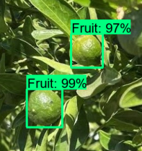
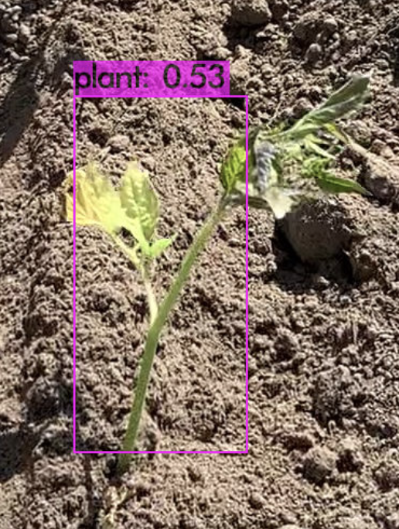
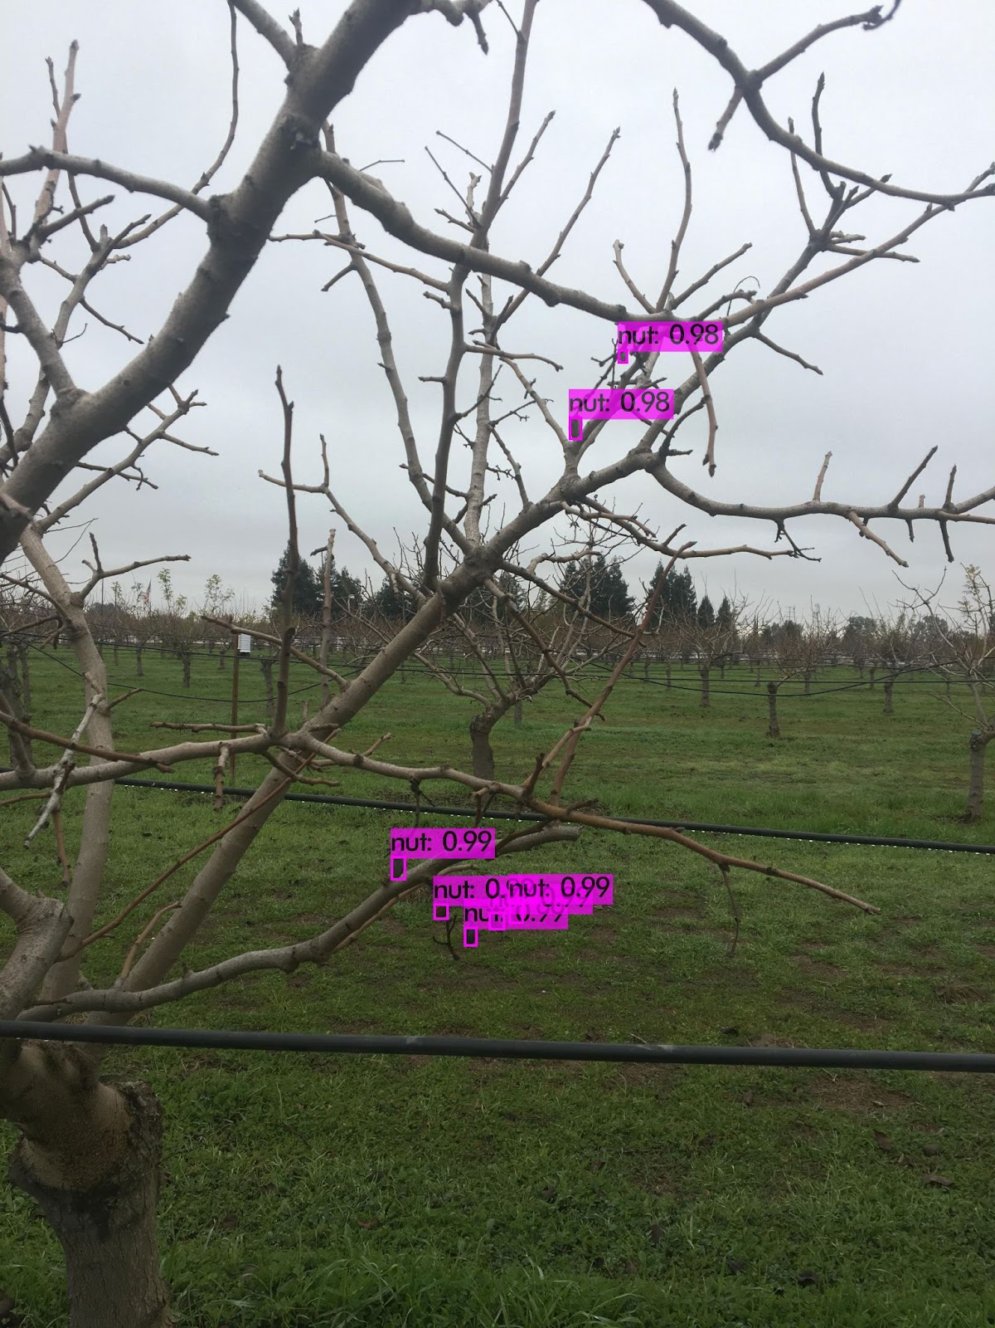
My AG Experience
Citrus Fruit Detection
TensorFlow object detection task
Detect camouflaged fruit
Morning Star Company
Team of 5
Developed vision system
System analyzes transplanting success
PADSYS: Almond Precision AG
Team of 4
Paper written
Notes:
Plant Counting System - YouTube

Slide 4
Content
Machine Learning and Convolutional Neural Networks
TensorFlow Applications
AgriFood: Precision Agriculture
TensorFlow Object Detection
Others

Slide 5
Content
Machine Learning and Convolutional Neural Networks
Machine Learning and subcategories
What is a Neural Network?
Practitioner Workflow
Evaluating Metrics and Improving Performance
Making your own Dataset!
TensorFlow Applications
AgriFood: Precision Agriculture
TensorFlow Object Detection
Others
Notes:
Aerial imagery, citrus fruit, mummy nuts, NLP, turn-based games,

Slide 6
Machine Learning and Neural Networks
Deep Learning (DL) is a category of Machine Learning (ML)
Convolutional Neural Networks (CNN) are a type of algorithm for DL models
Artificial Intelligence
Machine Learning
Deep Learning
GAN
CNN
RNN

Slide 7
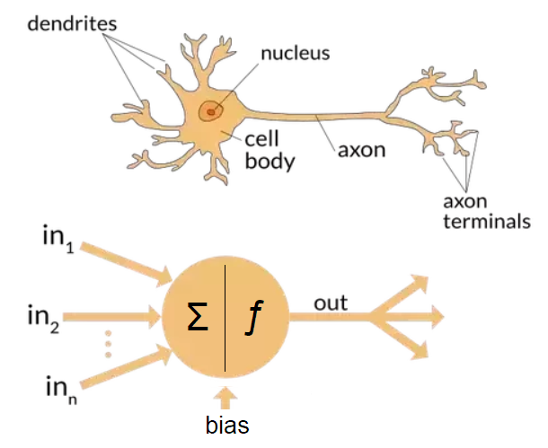
Neural Networks
Machine Learning vs Deep Learning:
ML is more classical approach using tables to learn
Requires more structured input from developer
DL involves multiple layers and neurons to simulate brain cells
Input can have more variety and less structured
-4. | -3. | -8. | -5. | -7.
-4. | -4. | -6. | -5. | -2.
-6. | -1. | -2. | 0. | -8.
-3. | -5. | -2. | -5. | -3.
-2. | -4. | -2. | -7. | -2.
Image courtesy: The differences between Artificial and Biological Neural Networks | by Richard Nagyfi | Towards Data Science
Notes:
Fig 1
Table consists of numbers corresponding to goodness value
Fig 2
each circle depicts a neuron
inputs on the left, layers inbetween, output at the end
during training, propagate forwards and backwards
make guesses, calculate error
adjust parameters

Slide 8
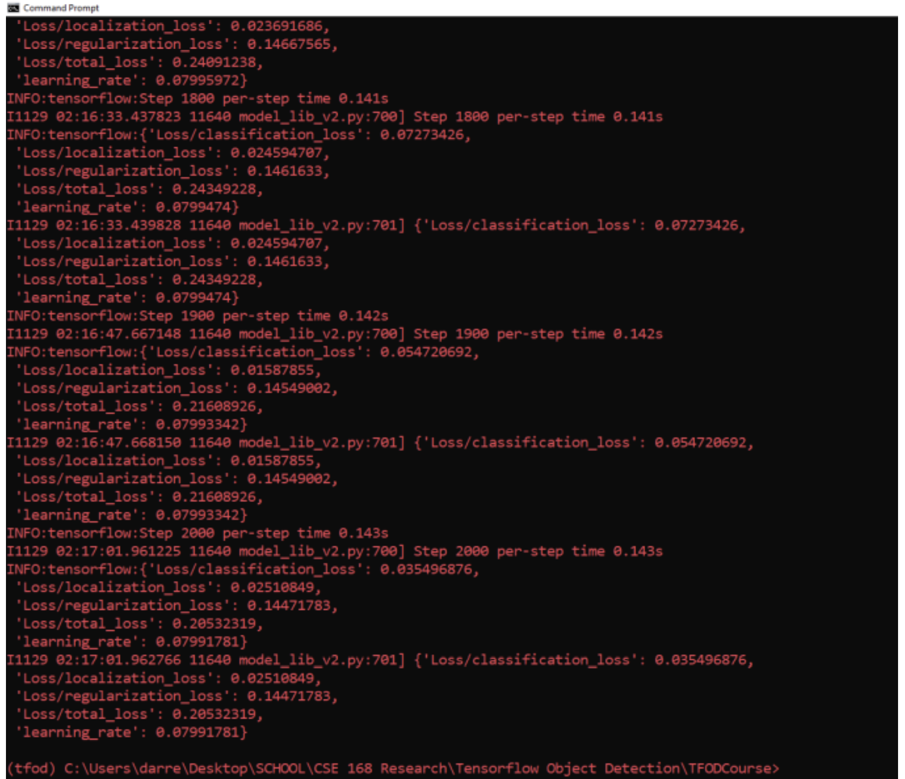
What’s inside the box?
Neural Networks often referred to as a “black box”
Model parameters are hidden from user
How to visualize?
A Neural Network Playground (tensorflow.org)
What if we need to improve the model?
Notes:
https://playground.tensorflow.org/#activation=tanh&batchSize=10&dataset=circle&regDataset=reg-plane&learningRate=0.03&regularizationRate=0&noise=0&networkShape=4,2&seed=0.26655&showTestData=false&discretize=false&percTrainData=50&x=true&y=true&xTimesY=false&xSquared=false&ySquared=false&cosX=false&sinX=false&cosY=false&sinY=false&collectStats=false&problem=classification&initZero=false&hideText=false

Slide 9
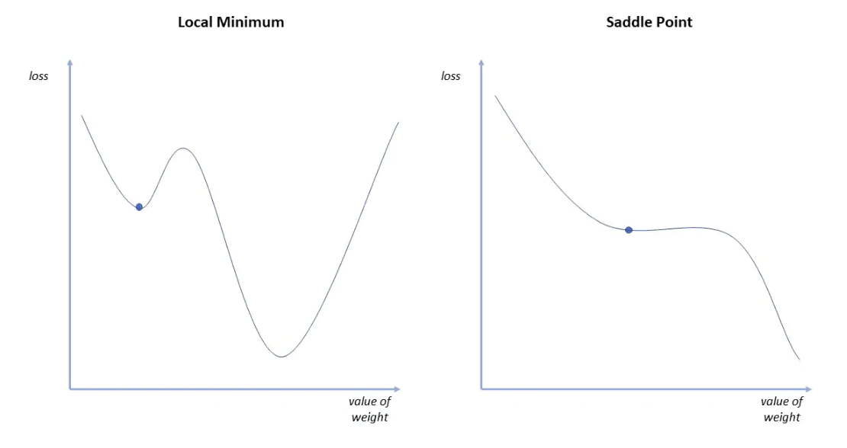
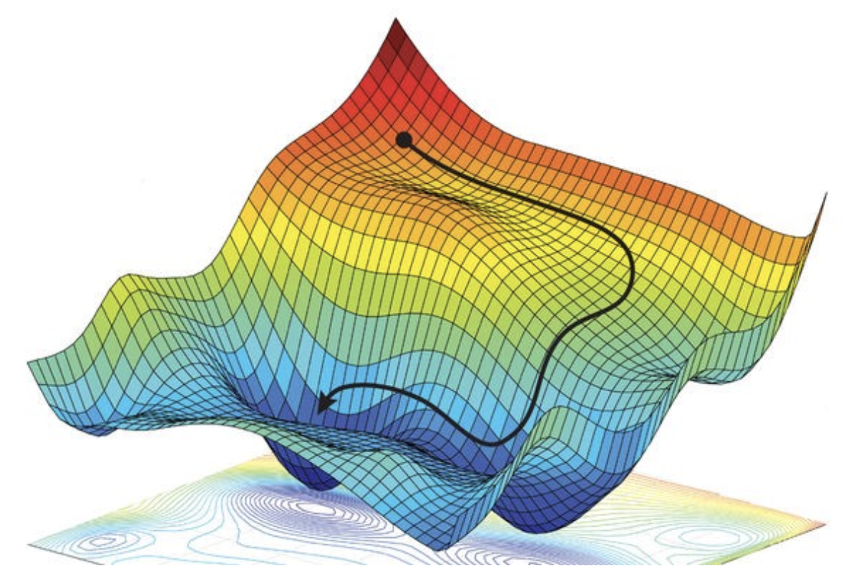
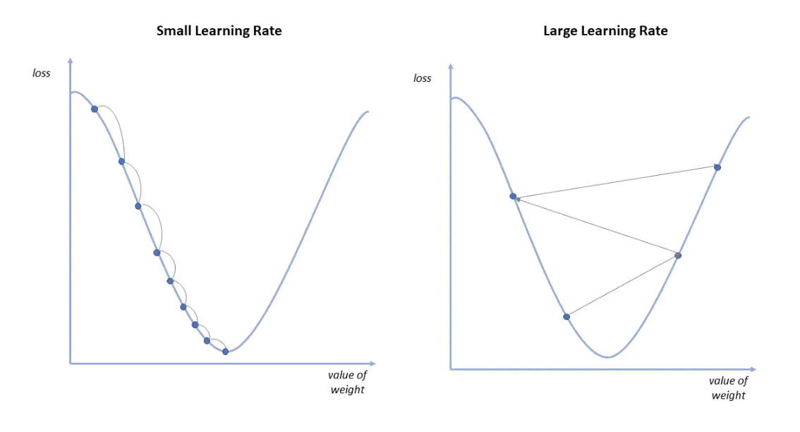
Training: Gradient Descent
Find the most optimal path down (convergence)
Descent rate can be adjusted with learning rate
Image Courtesy: https://towardsdatascience.com/coding-deep-learning-for-beginners-linear-regression-gradient-descent-fcd5e0fc077d, https://www.ibm.com/cloud/learn/gradient-descent

Slide 10
Neural Networks: Training vs Inference
Training
Requires a very large amount of computations
Largest network processes 95-125 million operations per forward pass
Can take a long time to train
For small dataset: maybe a few hours
For large dataset: days to weeks
Inference
When we want to perform detections
Very quick to run
Training results are compressed
A. Canziani, A. Paszke, and E. Culurciello, “An analysis of deep neural network models for practical applications,” Apr 2017. arXiv:1605.07678 [cs].

Slide 11
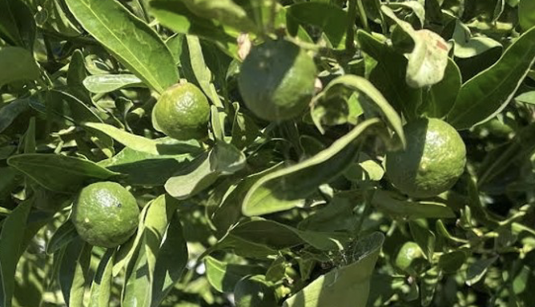
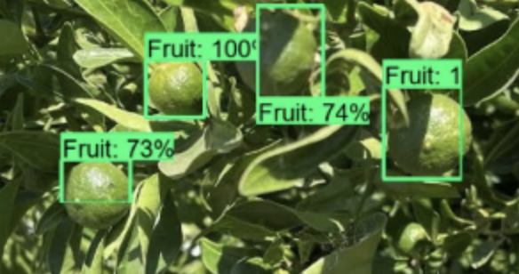
Neural Networks: Inference (Detections)
Inference (Compressed Model from training)
This whole process can take around 70ms with the fastest CNN model

Slide 12
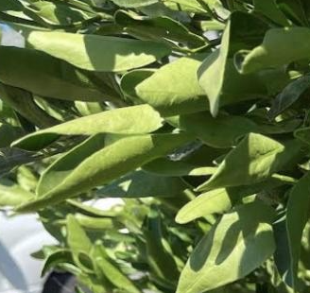
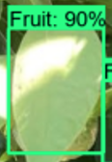
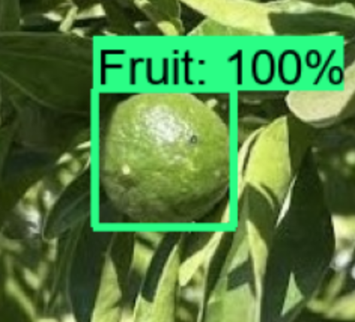
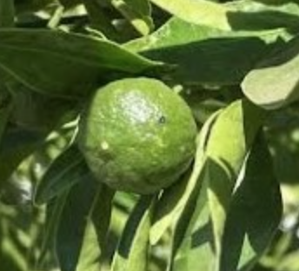
Bounding Box Performance
True Positive (TP)
True Negative (TN)
False Positive (FP)
False Negative (FN)
Precision: Proportion of correct detections = TP / (TP + FP)
Recall: Proportion of actual objects captured = TP / (TP + FN)
Loss: how well the model is performing against data provided

Slide 13
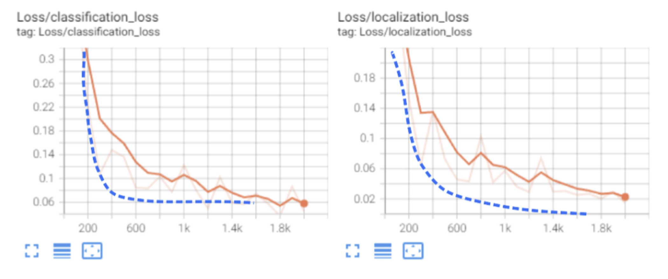
TensorBoard: Visualization Toolkit
Allows tracking and visualization of performance metrics
Visualizing model operations and layers
much more
TensorBoard: https://www.tensorflow.org/tensorboard
Notes:
- TensorBoard also comes from TensorFlow
Take a look at the graphs
- orange shows

Slide 14
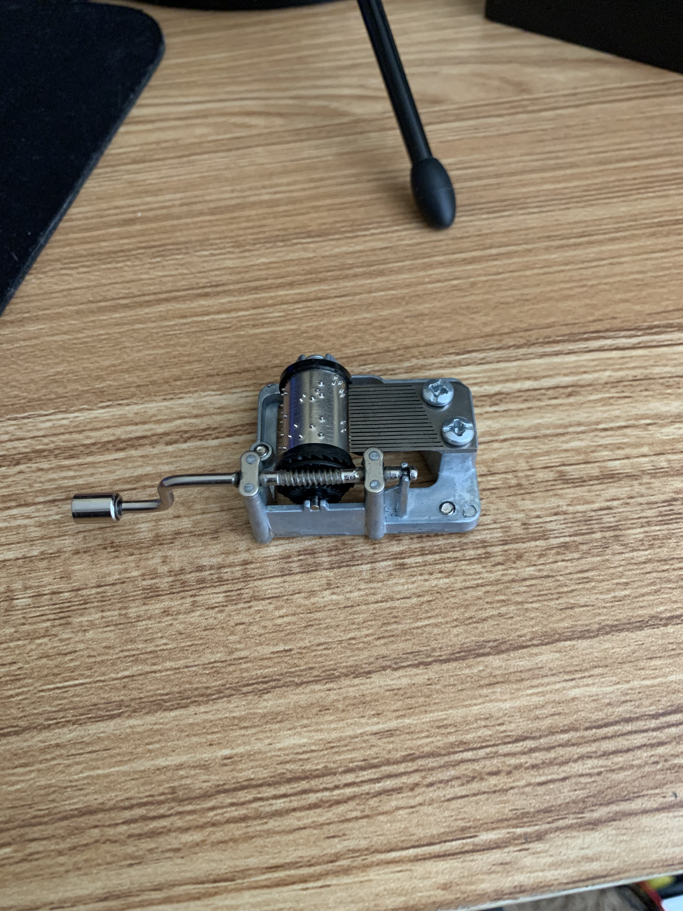
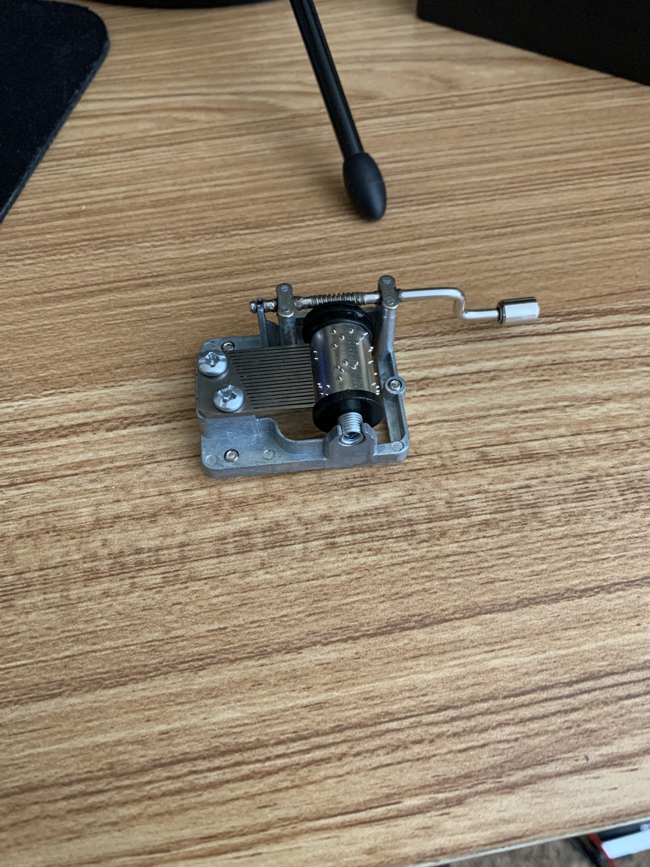
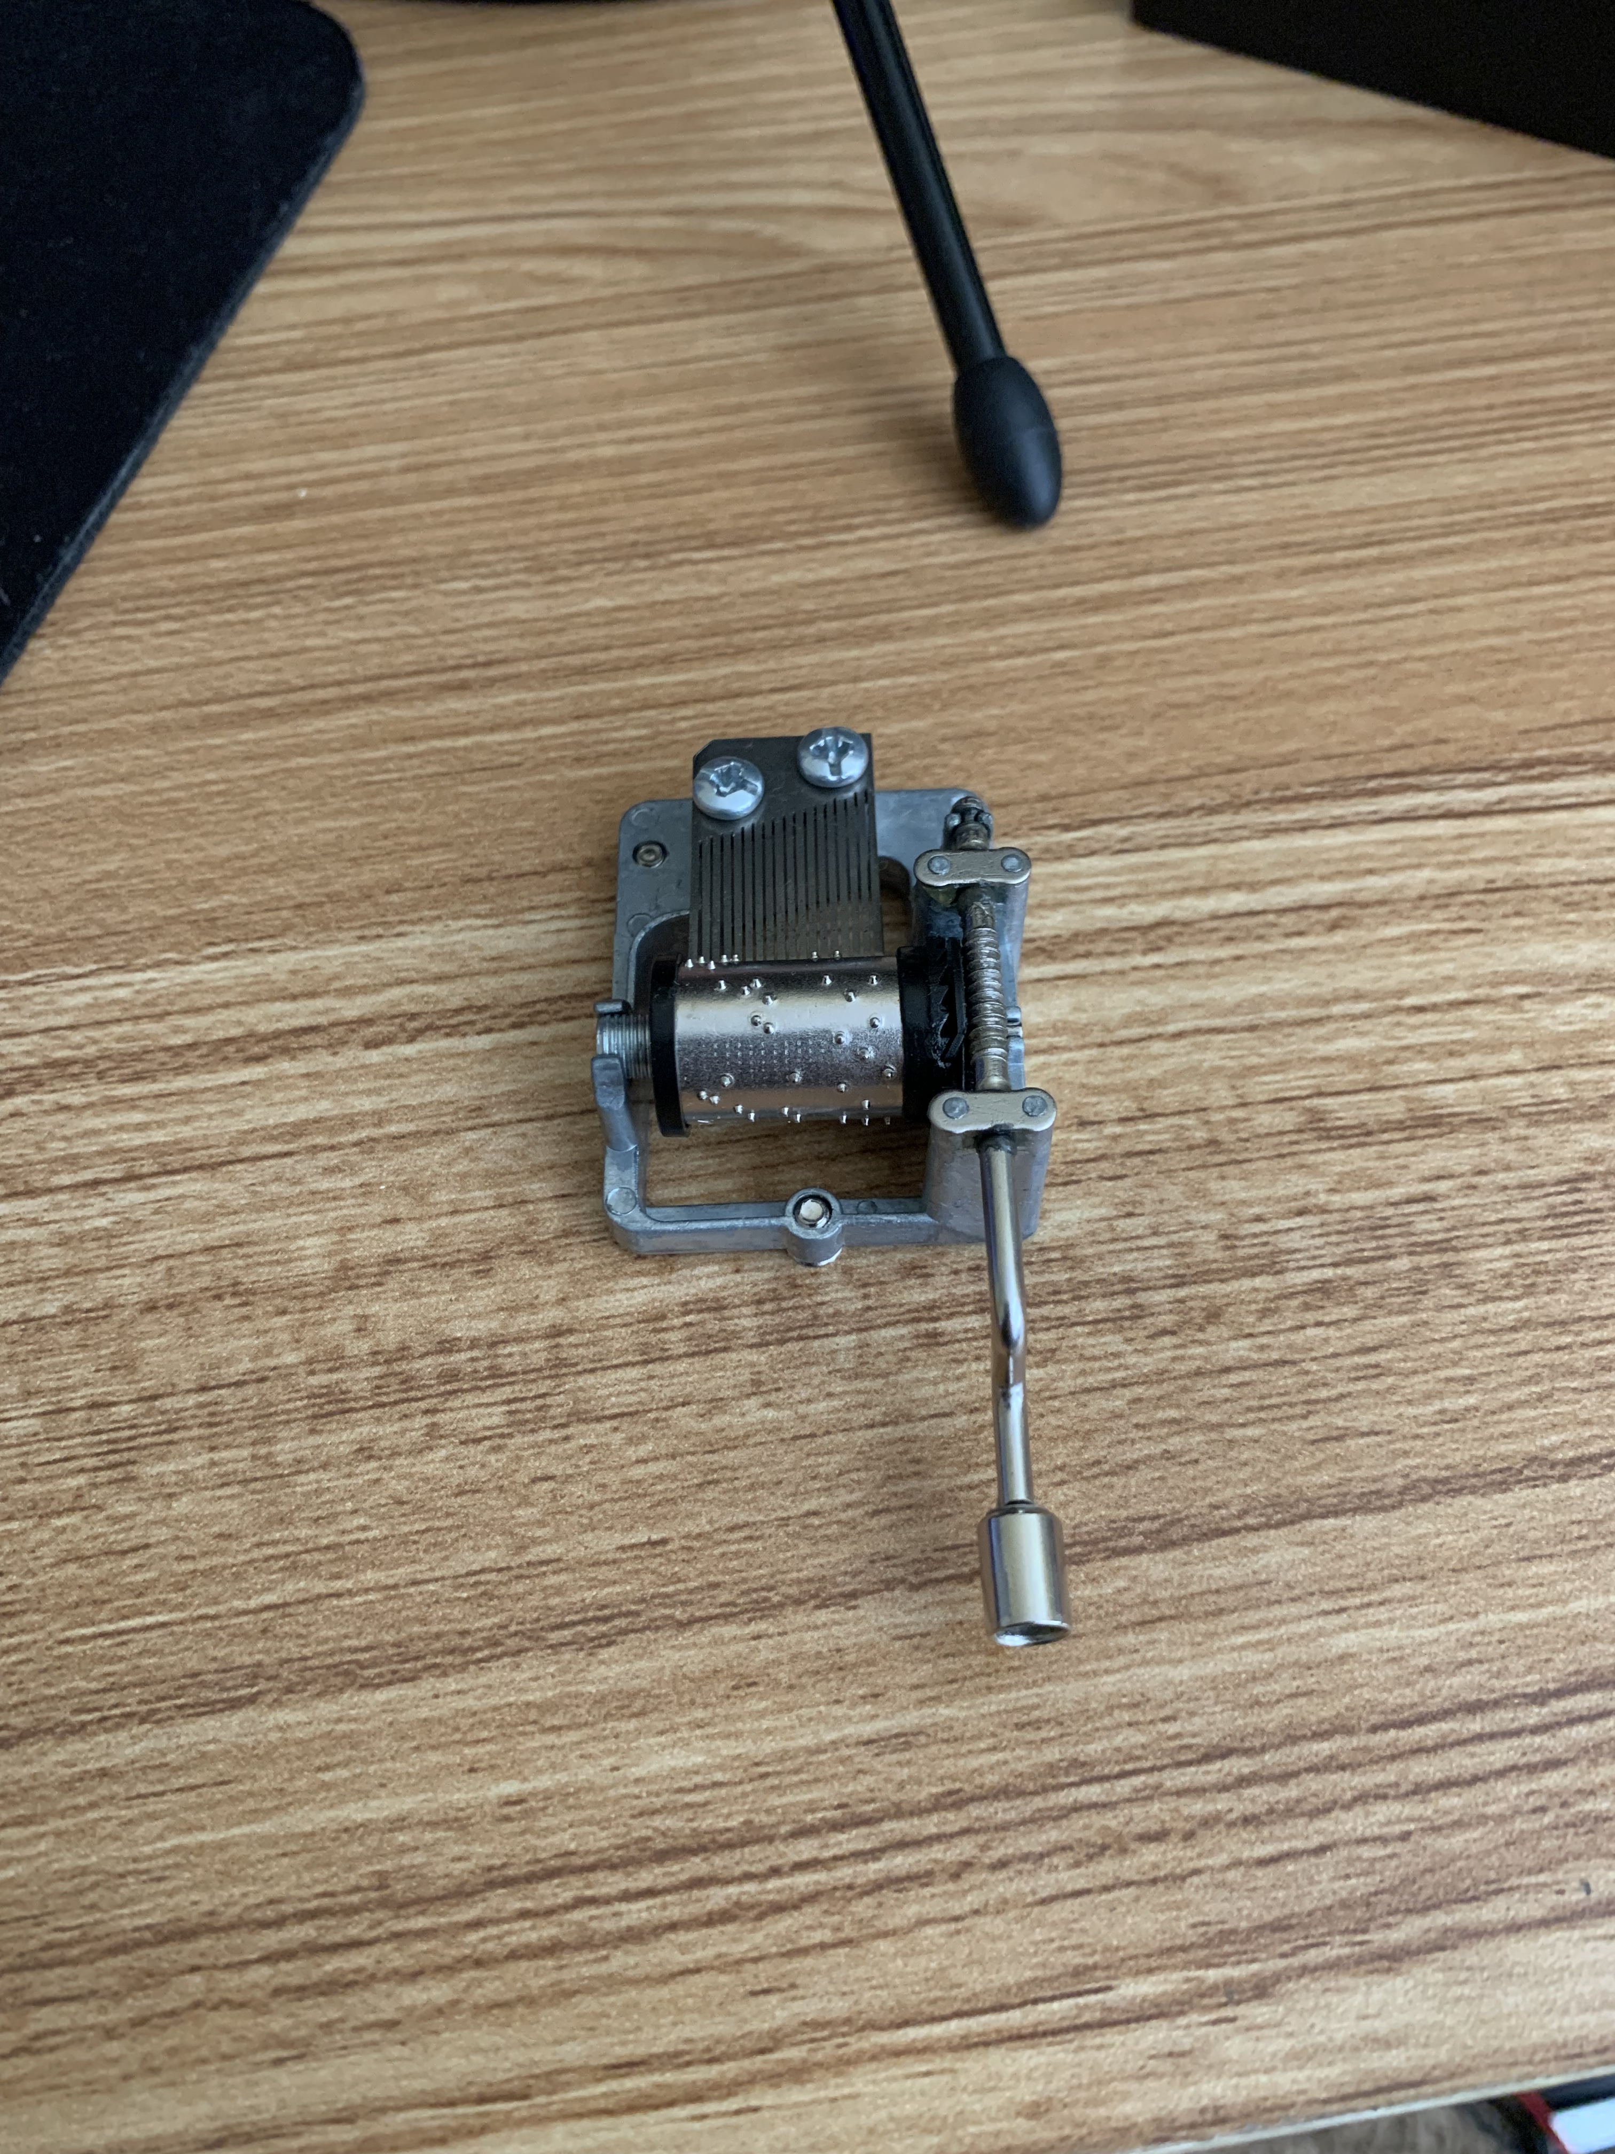
Making your own dataset
Collect images containing your target image
Capture different angles

Slide 15
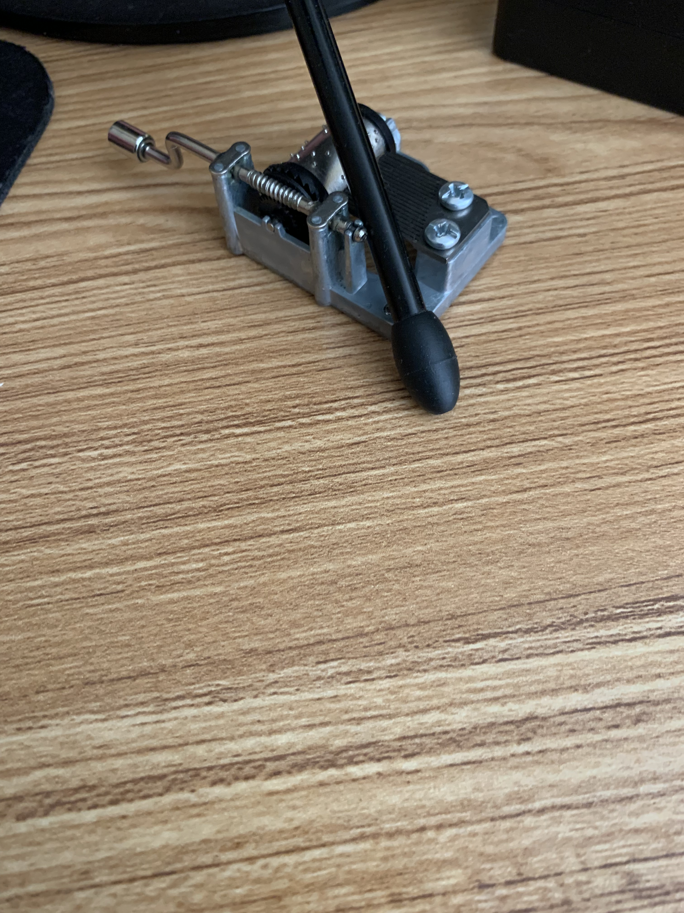
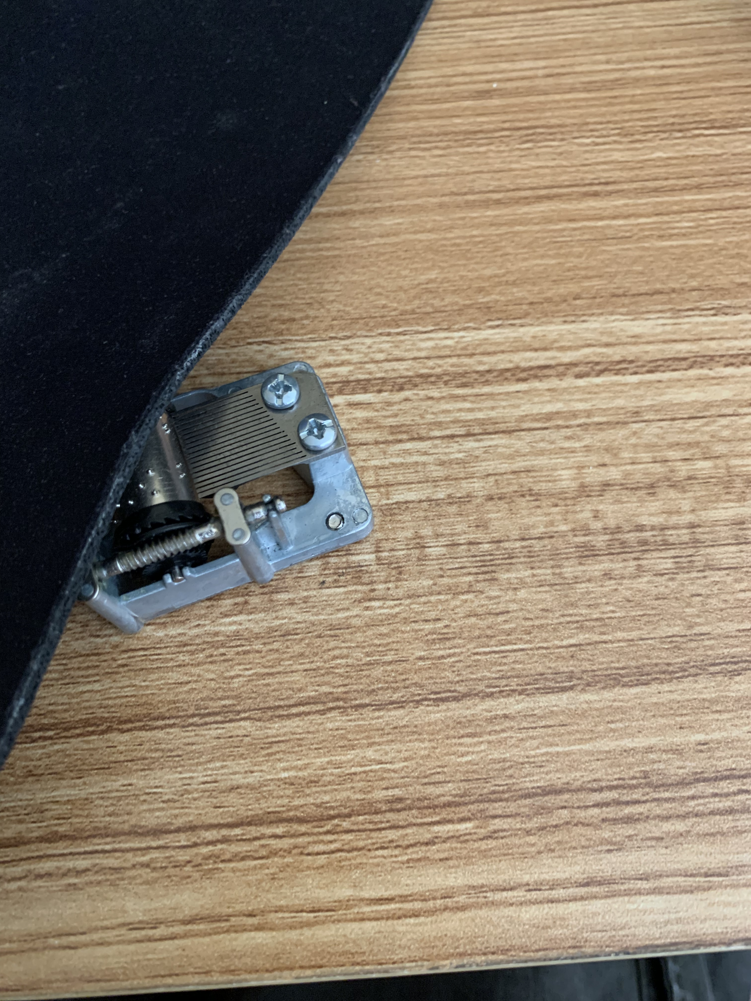

Slide 16
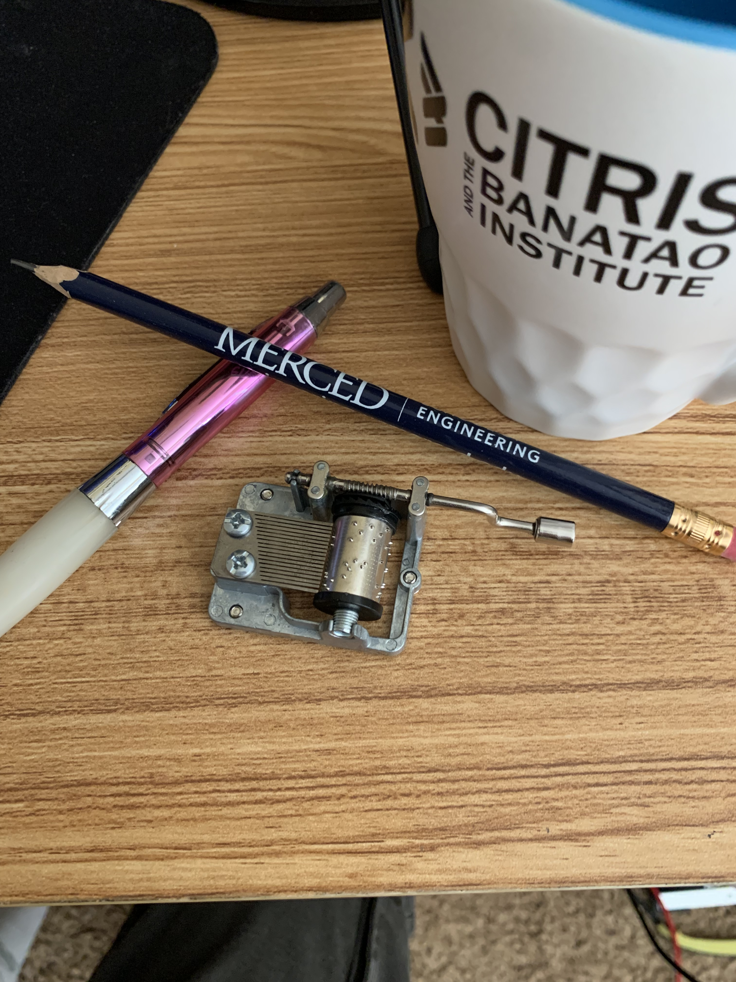
Raw Image
Annotated

Slide 17
Annotating for Object Detection
If you want to make your own custom dataset
Tips:
Annotate ALL instances of target object, even if cut-off in image
Keep annotation bounding boxes as tight to object as possible
Background objects are good sometimes, lets network understand what does not classify as target object
Multiple Different Platforms:
Roboflow: Roboflow: Give your software the power to see objects in images and video
LabelImg: https://github.com/heartexlabs/labelImg
LabelMe: wkentaro/labelme: Image Polygonal Annotation with Python (polygon, rectangle, circle, line, point and image-level flag annotation). (github.com)
Notes:
https://www.youtube.com/watch?v=mUPR-aaFccA

Slide 18
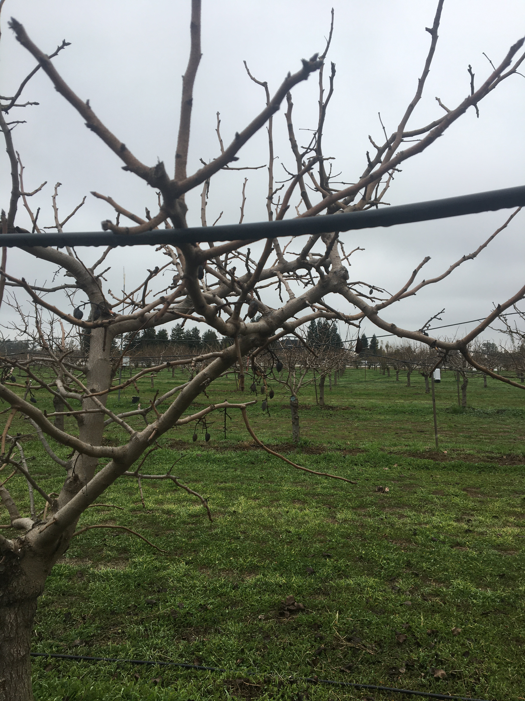
Adding Image Processing
Possible to learn more features
Make object detector more robust
Remove large amounts of noise

Slide 19
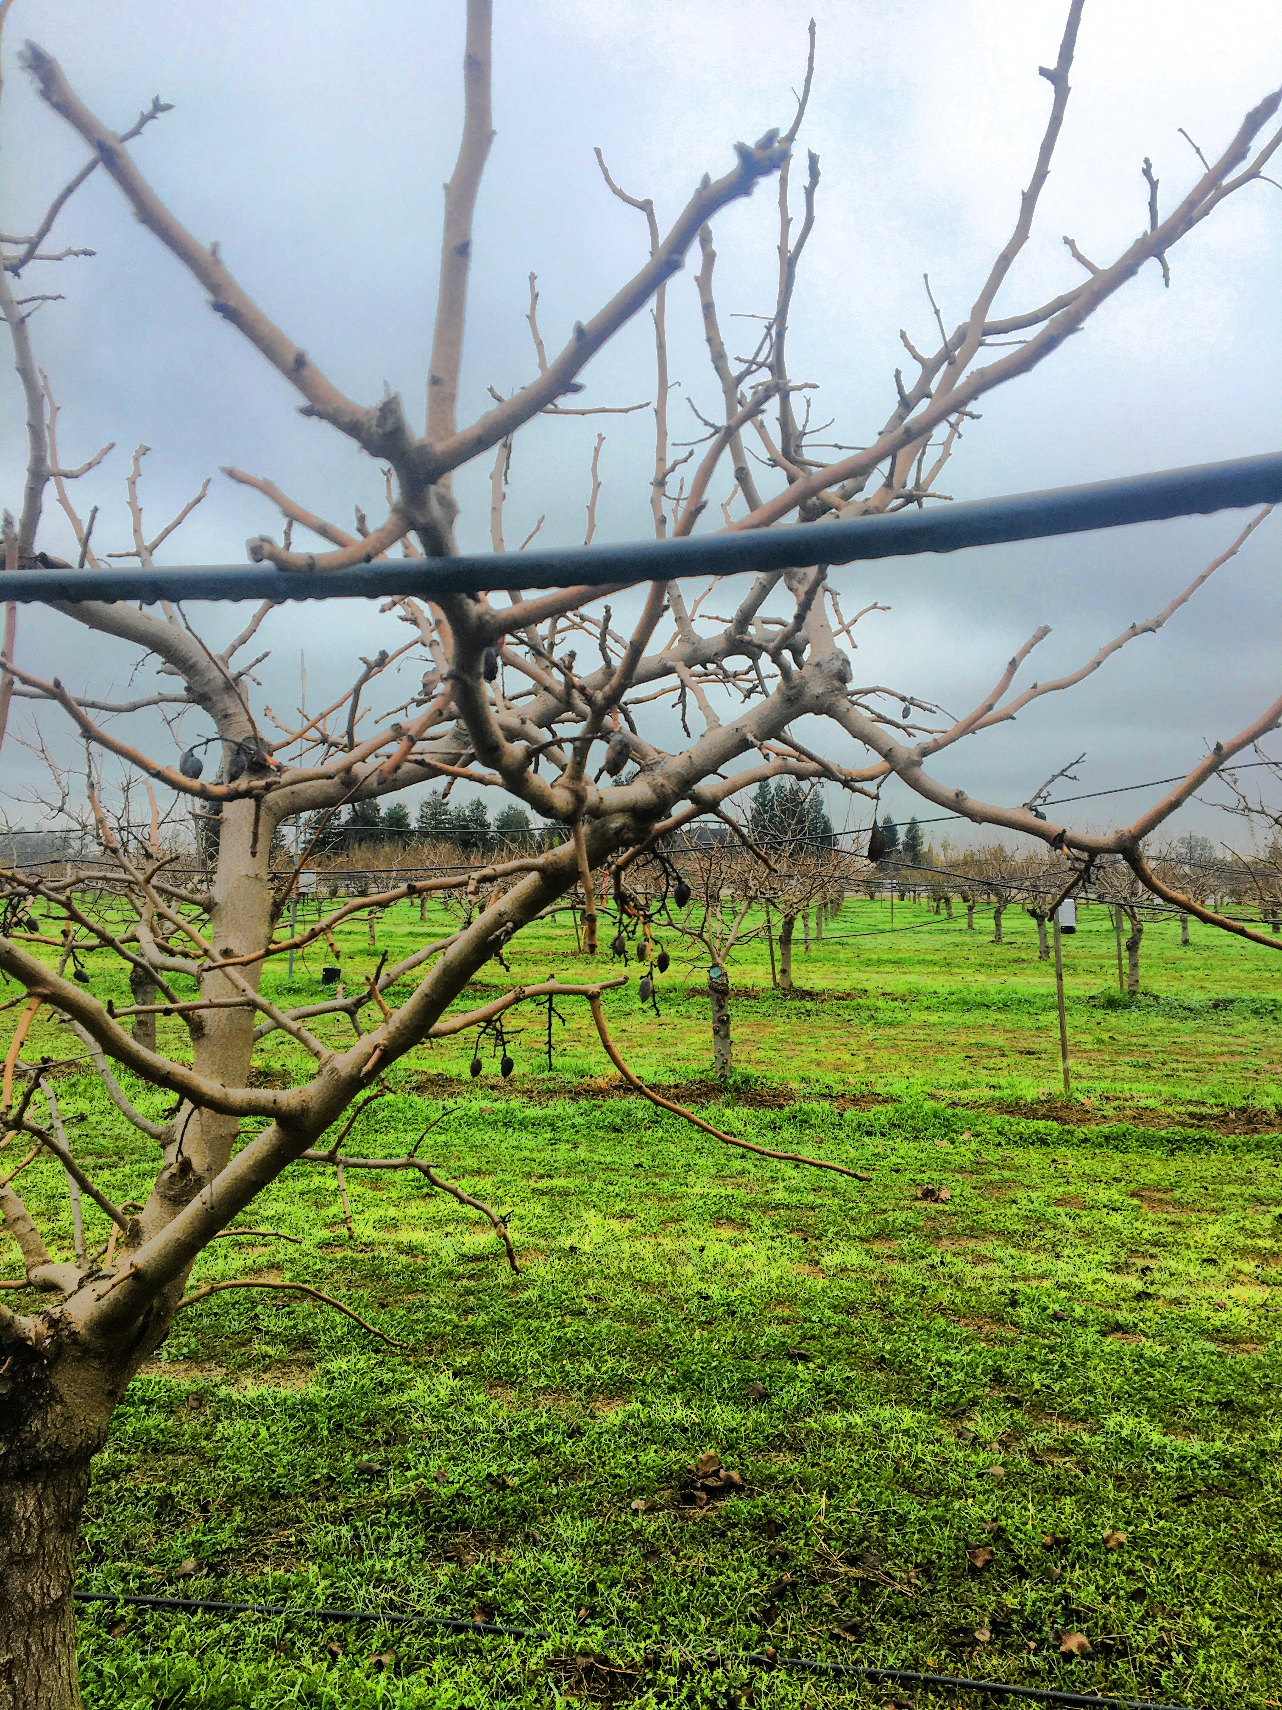
Image courtesy: Colin Schmierer

Slide 20
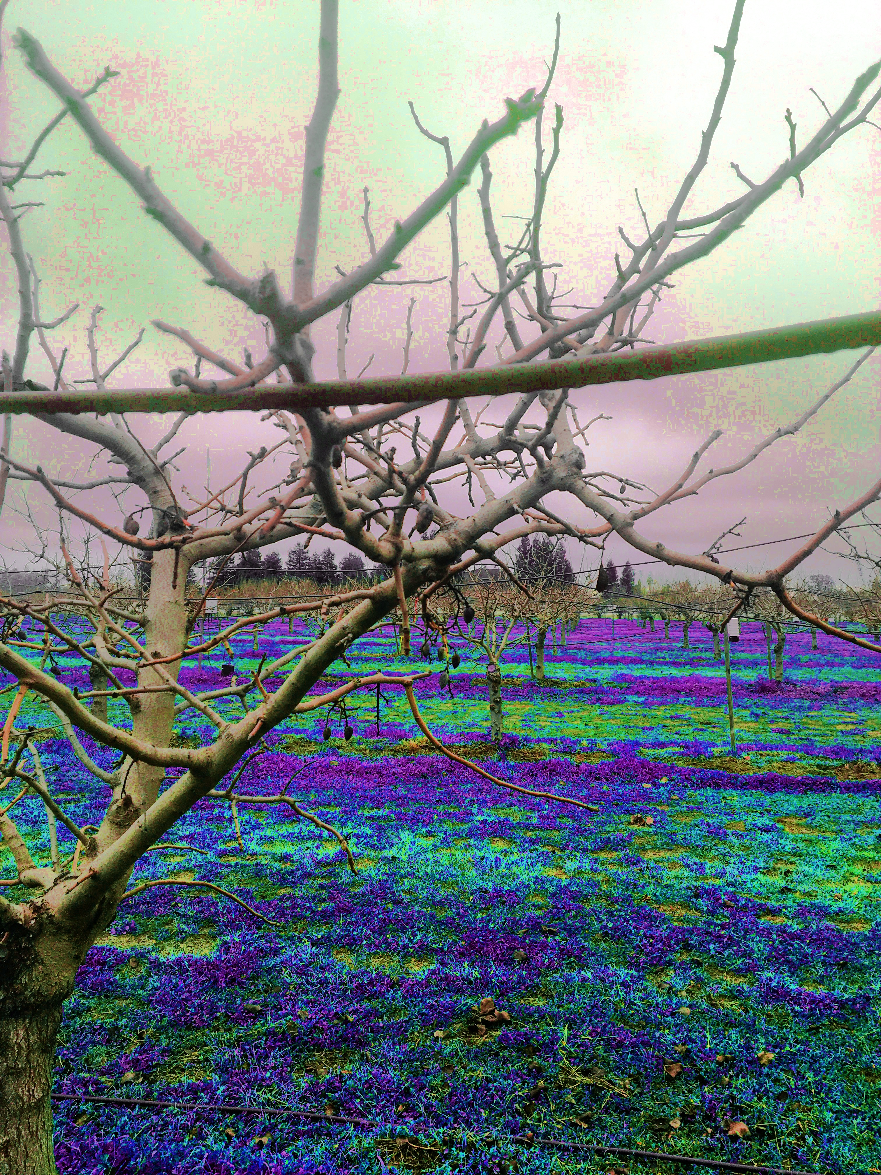
Image courtesy: Colin Schmierer

Slide 21
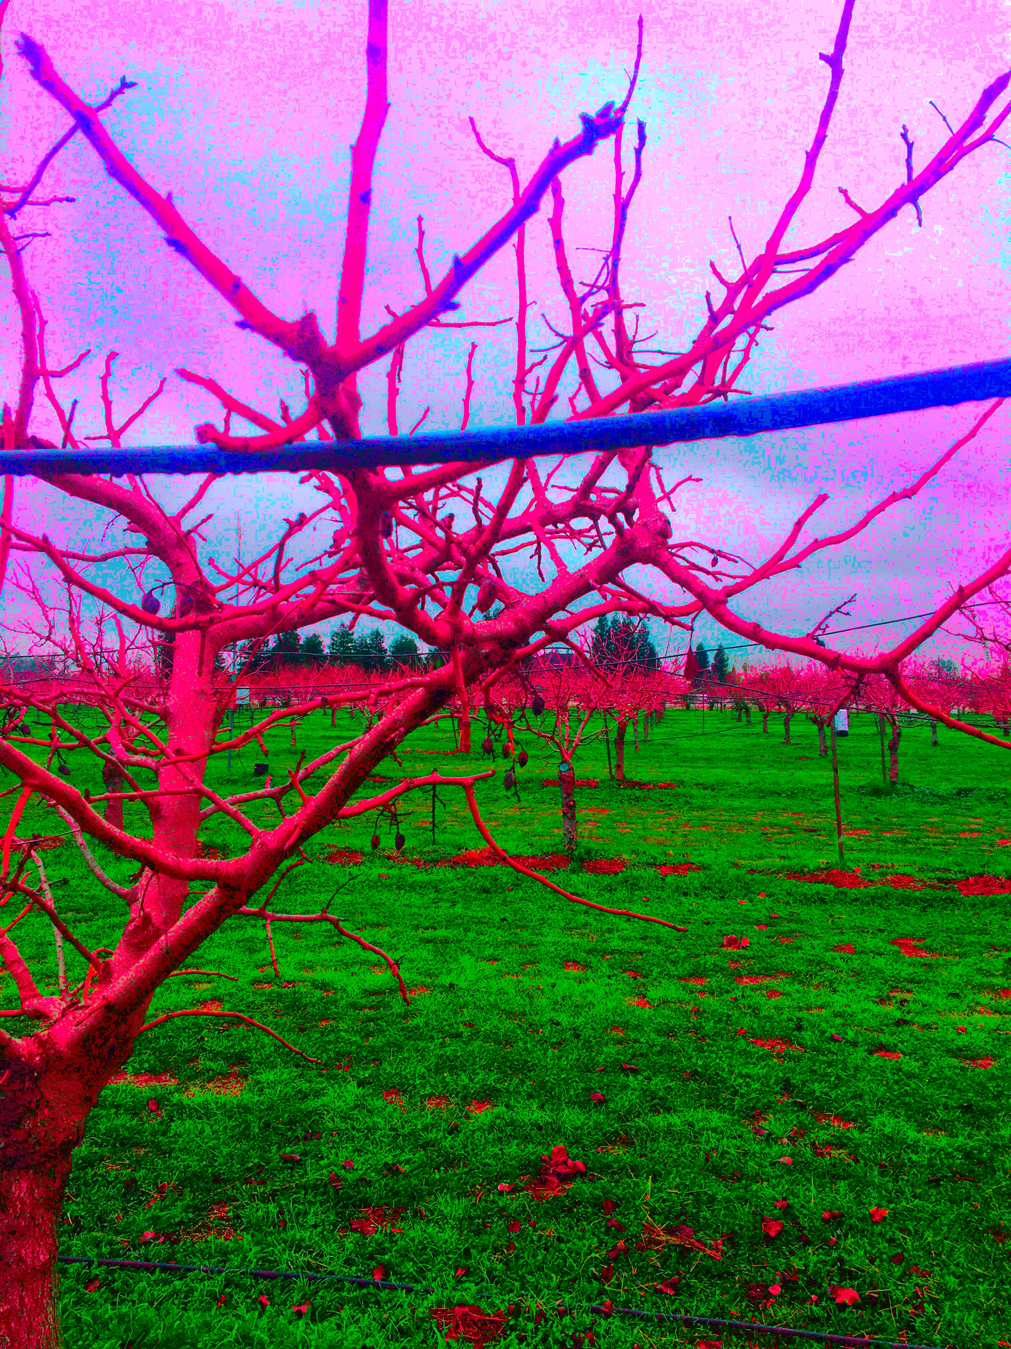
Image courtesy: Colin Schmierer

Slide 22
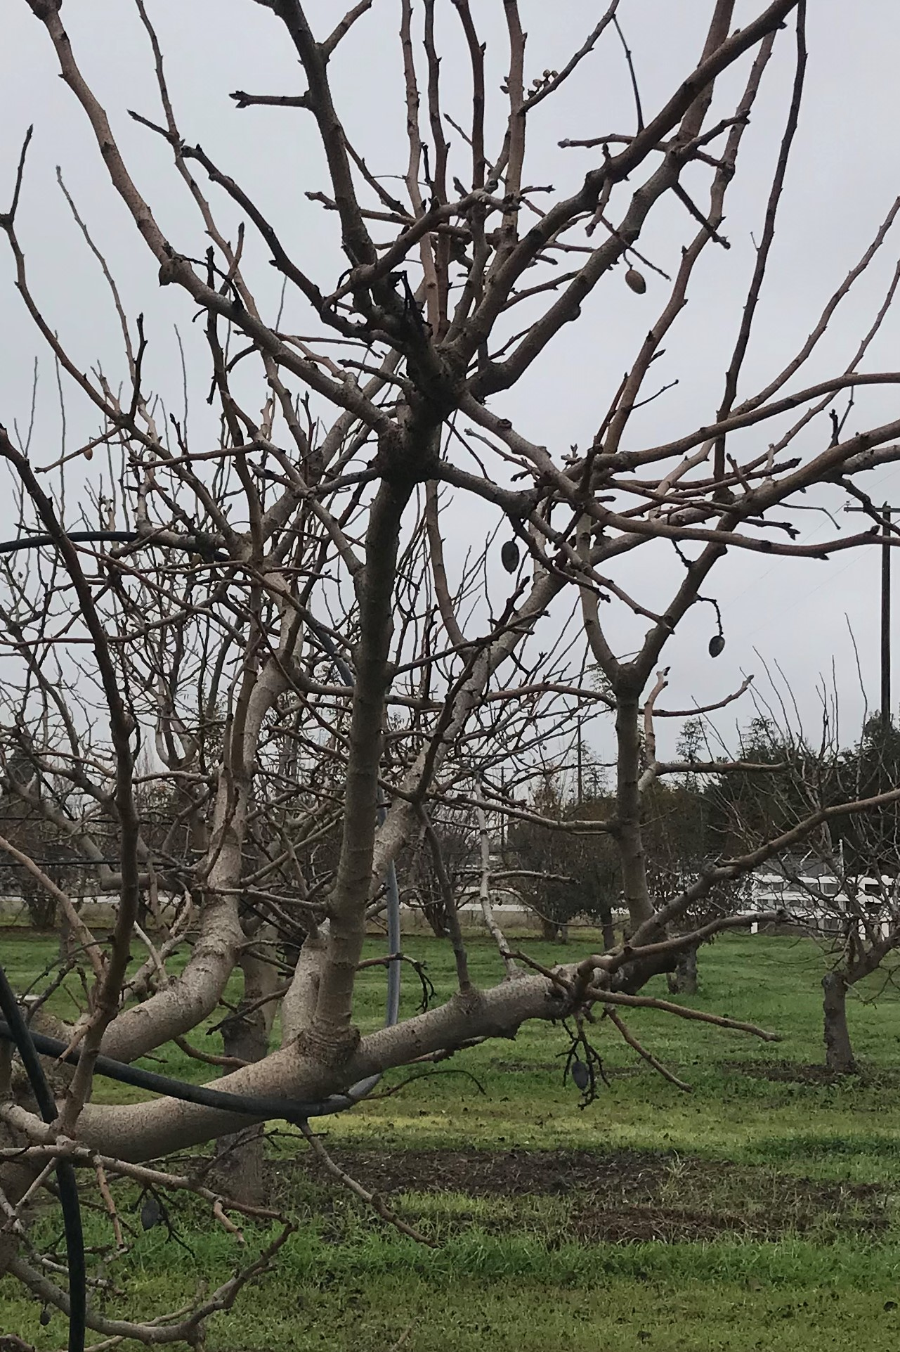
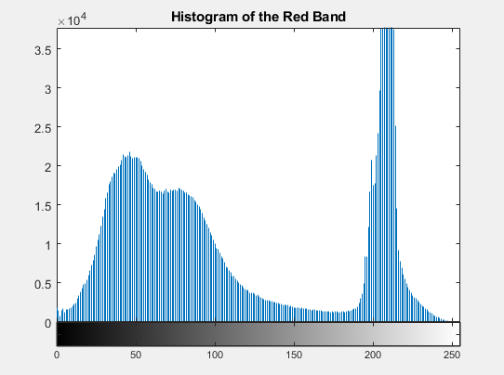
Image before processing:
Histogram of red channel shows that contrast is very poor dude to large groupings

Slide 23
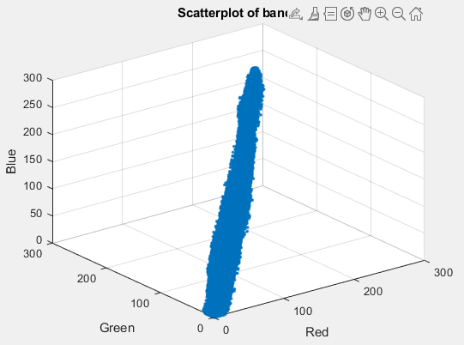
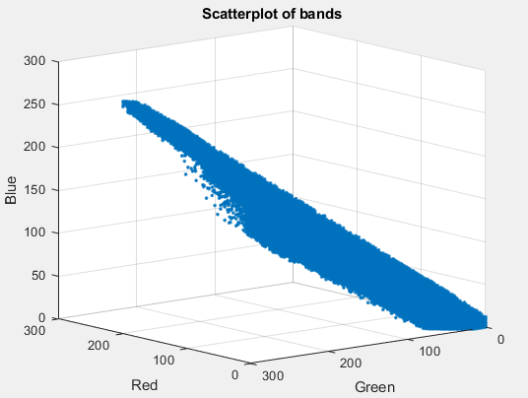
Image before processing:
Now if we plot on a 3d graph, we can even more clearly observe the contrast issue across all channels. Our pixel colors are clustered too close together and gives very low contrast

Slide 24
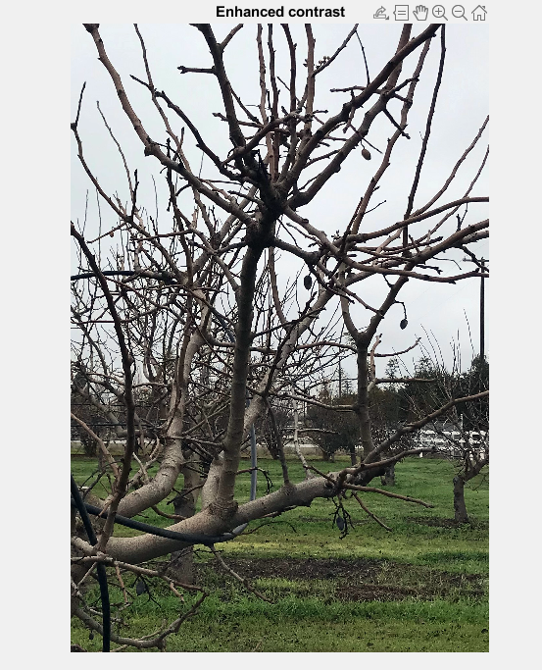
Image after 1st step of processing
This filter is a very simple contrast sharpening. It is a very slight change but can make a strong difference. This is done by using a matlab function in the image processing toolbox called imadjust.

Slide 25
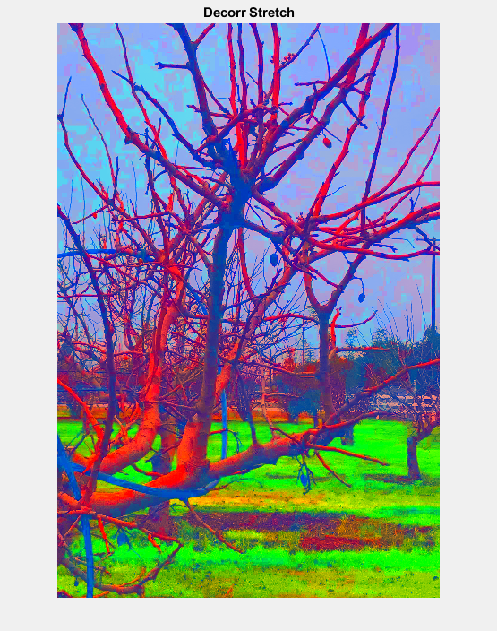
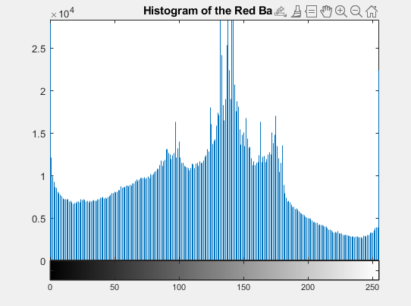
Image after 2nd step of processing
Now we can see good distribution within our red band which tells us we have much better contrasts

Slide 26
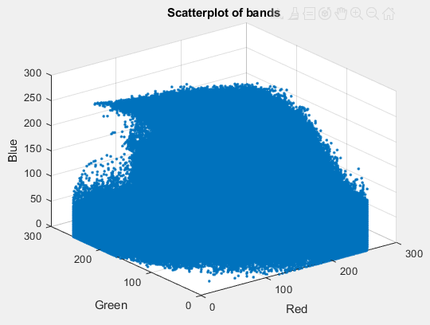
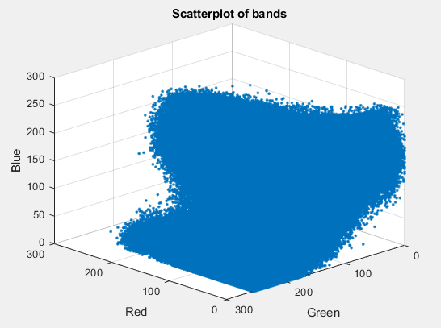
Image after 2nd step of processing
And like our red band, all the other channels show strong contrasts now and are no longer tightly clustered

Slide 27
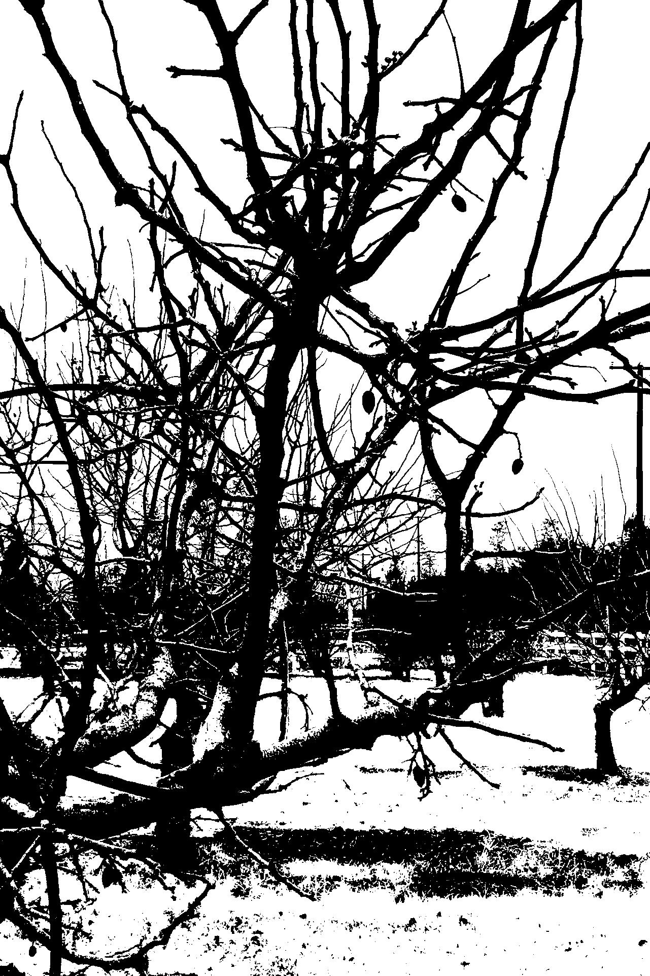
Image after 3rd step of processing
Now we can apply a thresholding value after converting the high-contrast image into grayscale to receive a binary output
Improvements:
Remove branches (maybe find all straight lines and classify as branch for removal)
Reduce grass highlights more
Learn more: https://www.youtube.com/watch?v=1-jURfDzP1s

Slide 28


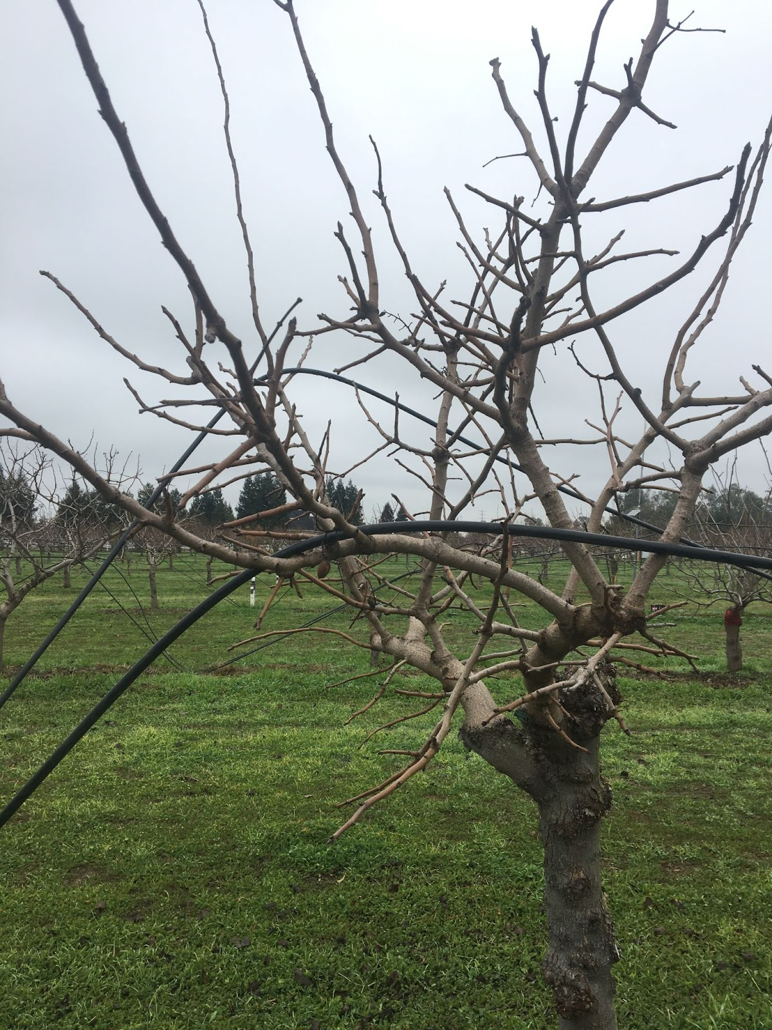
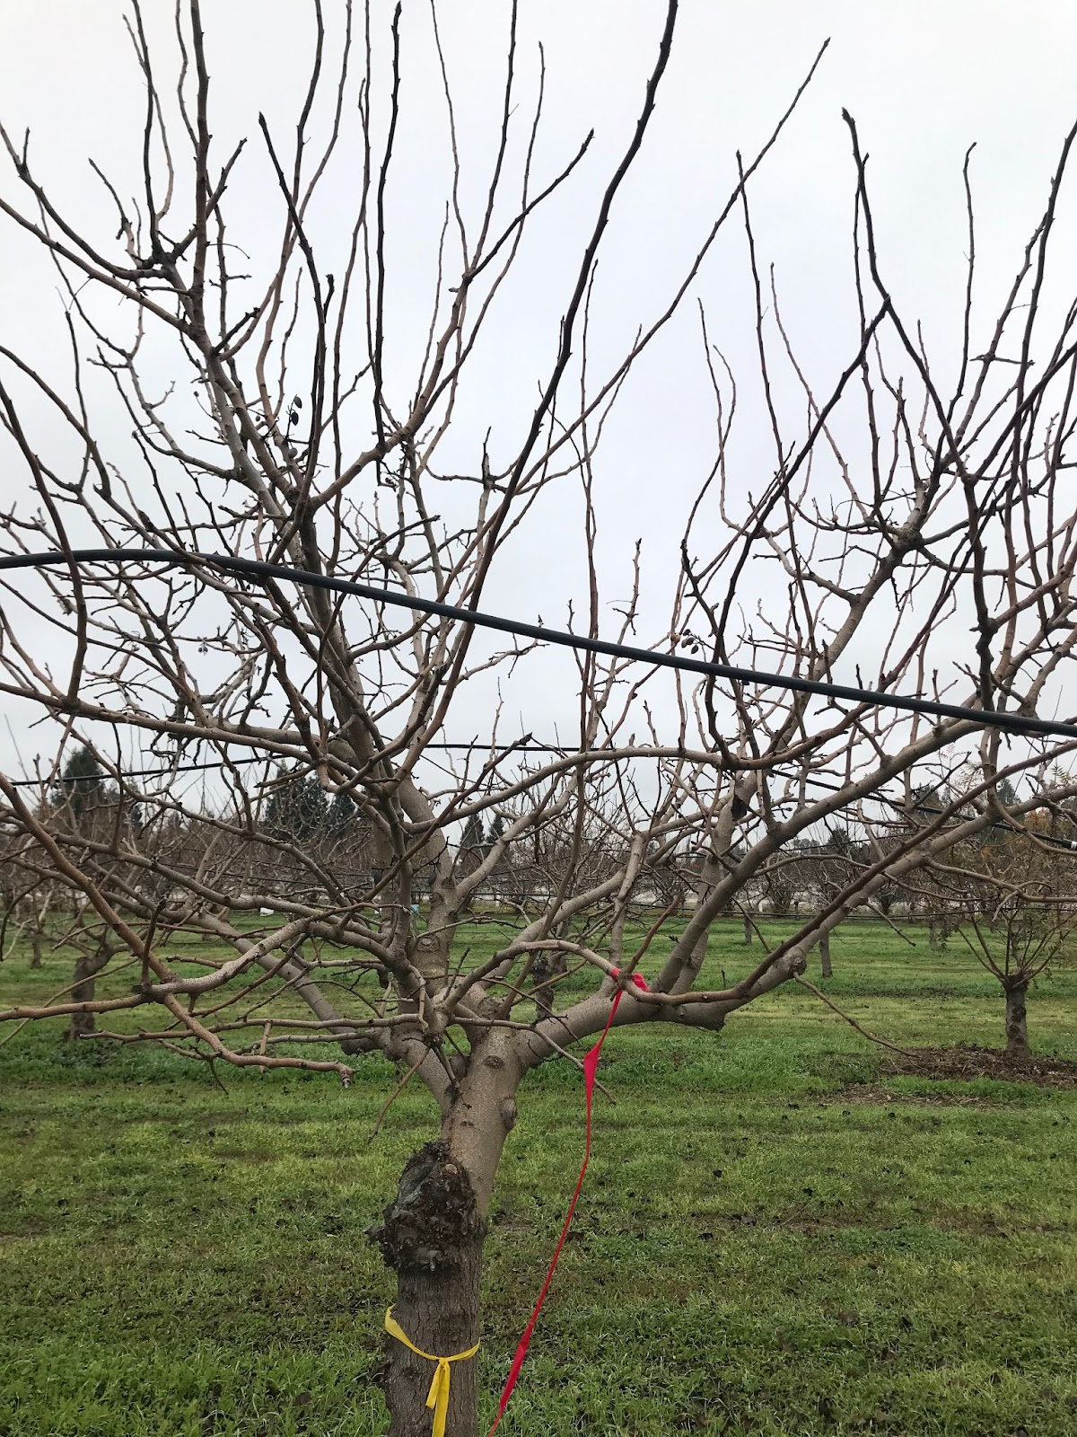
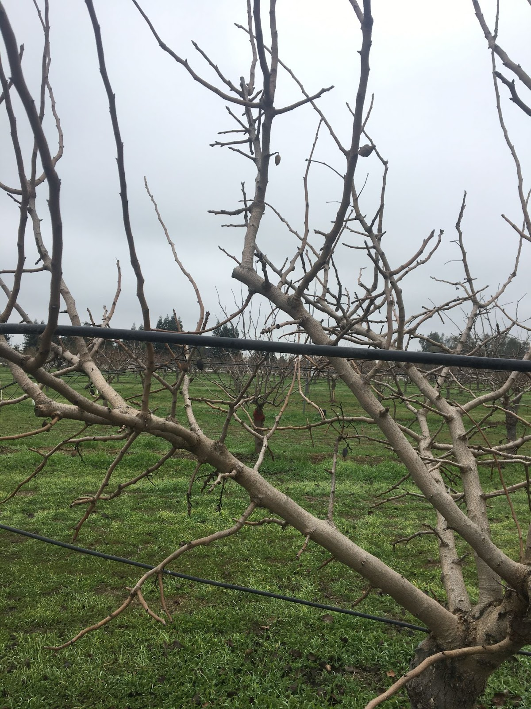
Training Neural Network: Workflow
Inference
Training Evaluation
Input
Annotate
Training
Cloud Training
Dataset
Trained Model
Local Training
Detection
Accuracy Evaluation

Slide 29
Content
Machine Learning and Convolutional Neural Networks
Machine Learning and subcategories
What is a Neural Network?
Practitioner Workflow
Evaluating Metrics and Improving Performance
Making your own Dataset!
TensorFlow Applications
AgriFood: Precision Agriculture
TensorFlow Object Detection
Others
Notes:
Aerial imagery, citrus fruit, mummy nuts, NLP, turn-based games,

Slide 30
Content
Machine Learning and Convolutional Neural Networks
TensorFlow Applications
AgriFood: Precision Agriculture
Problem Statement
CNN Models
Mummy Almond Nut Problem
Morning Star Company
TensorFlow Object Detection
Others
Notes:
Aerial imagery, citrus fruit, mummy nuts, NLP, turn-based games,

Slide 31
AgriFood: NOW Disease
Navel Orangeworm (NOW) is a pest that directly attacks almond kernels (mummy nuts)
Reducing almond yield and increasing reproduction of NOW
NOW infestation associated with Aspergillus spp. and aflatoxin
Human carcinogen
Solution:
Sanitation of mnuts is key to mitigate NOW infestation
Large expense: $220/acre
Notes:
fafdasf

Slide 32
AgriFood: Monitoring NOW Disease
Large-scale equipment required to efficiently remove mnuts
Lots of planning!
Process:
Machine or worker traverses each row of almond tree
Some concentration of trees may have significantly less than others
Tiny, hard to spot
Solution??

Slide 33
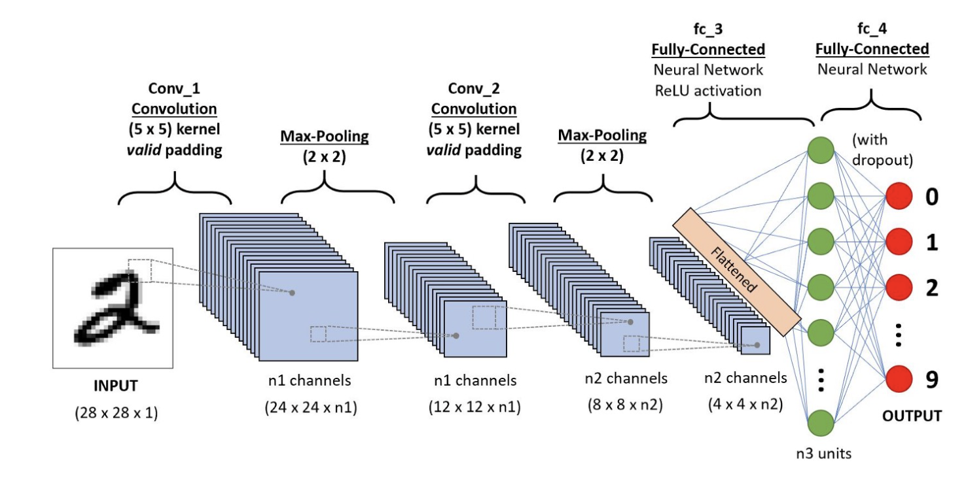
Convolutional Neural Networks
Very popular for object detection task
Learns features in any given image environment (num of features vary from network to network)
Image courtesy: https://towardsdatascience.com/a-comprehensive-guide-to-convolutional-neural-networks-the-eli5-way-3bd2b1164a53

Slide 34
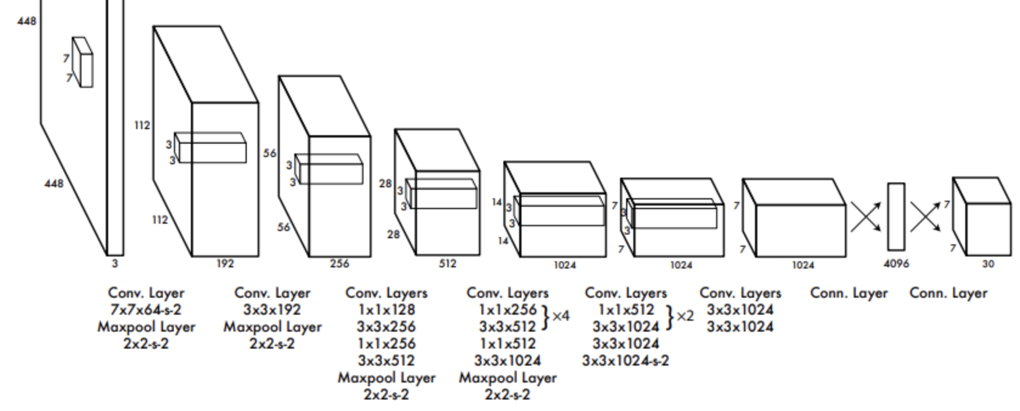
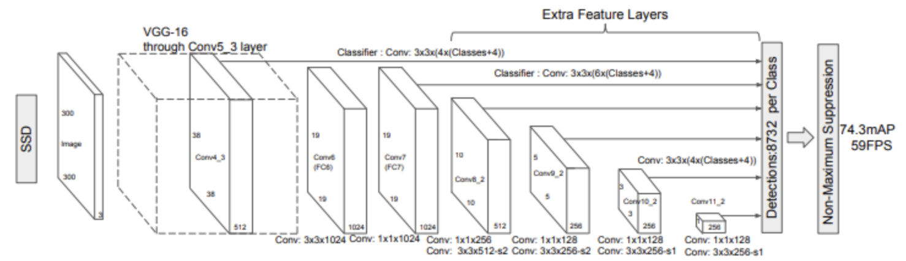
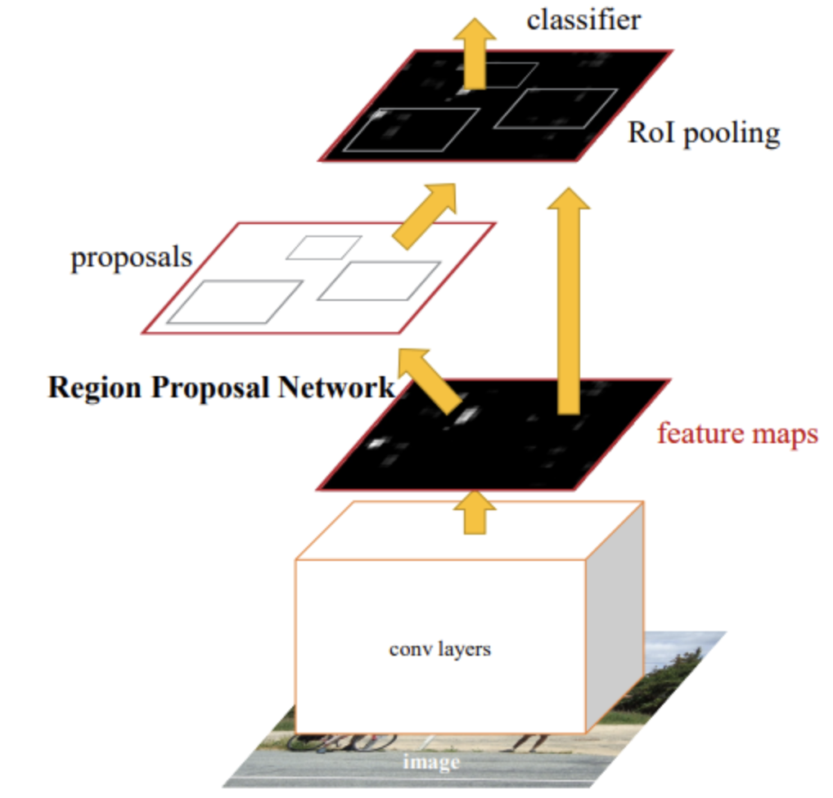
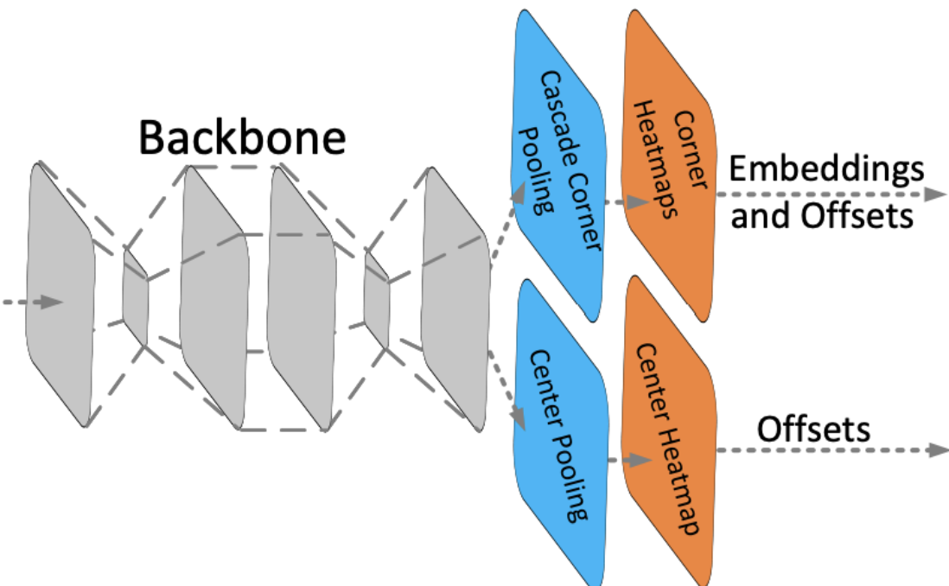
Convolutional Neural Networks
But... which one?
YOLO
SSD
FRCNN
CenterNet
You Only Look Once (YOLO): J. Redmon, S. Divvala, R. Girshick, and A. Farhadi, “You only look once: Unified, real-time object detection,” 2015.
Single Shot MultiBox Detector (SSD): W. Liu, D. Anguelov, D. Erhan, C. Szegedy, S. Reed, C.-Y. Fu, and A. C. Berg, “SSD: Single shot MultiBox detector,” in Computer Vision – ECCV 2016, pp. 21– 37, Springer International Publishing, 2016.
Faster R-CNN (FRCNN): S. Ren, K. He, R. Girshick, and J. Sun, “Faster r-cnn: Towards real-time object detection with region proposal networks,” 2015.
CenterNet: K. Duan, S. Bai, L. Xie, H. Qi, Q. Huang, and Q. Tian, “Centernet: Keypoint triplets for object detection,” 2019.

Slide 35
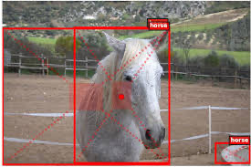


CNN Algorithms
Each type of CNN model features a different detection algorithm
Can become difficult to select which model
Time consuming to experiment between all of them
Performance metrics vary = hard to evaluate

Slide 36
Mummy Nut Object Detection Benchmark
Curate real-world datasets for mummy nut
Present two datasets: Original and Augmented
Designed easy-to-use benchmarking tools
Provide guidance for different proposed solutions
Two-dimensional benchmarking methodology
Accuracy and Latency
D. Ng, C. Schmierer, A. Lin, B. Liu, L. Yu, S. Newsam, R. Ehsani, and X. Lu, “Benchmarking Object Detection Models with Mummy Nuts Datasets”, Bench’22. (To Present)

Slide 37
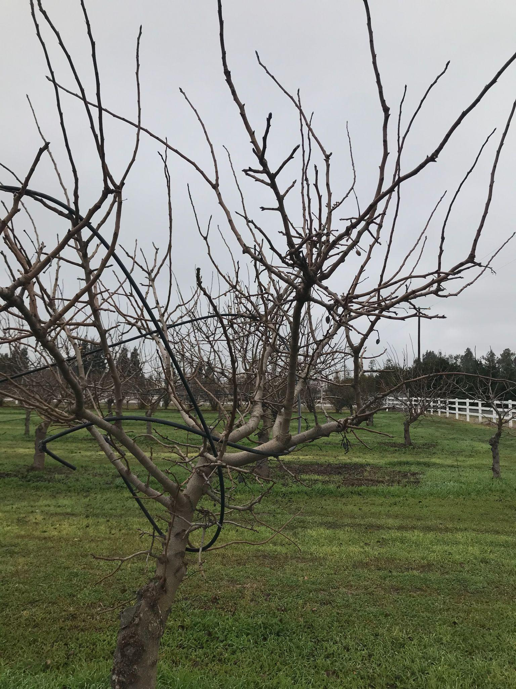
Challenges of the Dataset
-Camo
-Bundle
-Smaller
-Some half-visible
-Noisy background
-Low light
-Low light
Sum:
-Too much noise
-Too much variation
-Blending in
D. Ng, C. Schmierer, A. Lin, B. Liu, L. Yu, S. Newsam, R. Ehsani, and X. Lu, “Benchmarking Object Detection Models with Mummy Nuts Datasets”, Bench’22. (To Present)

Slide 38
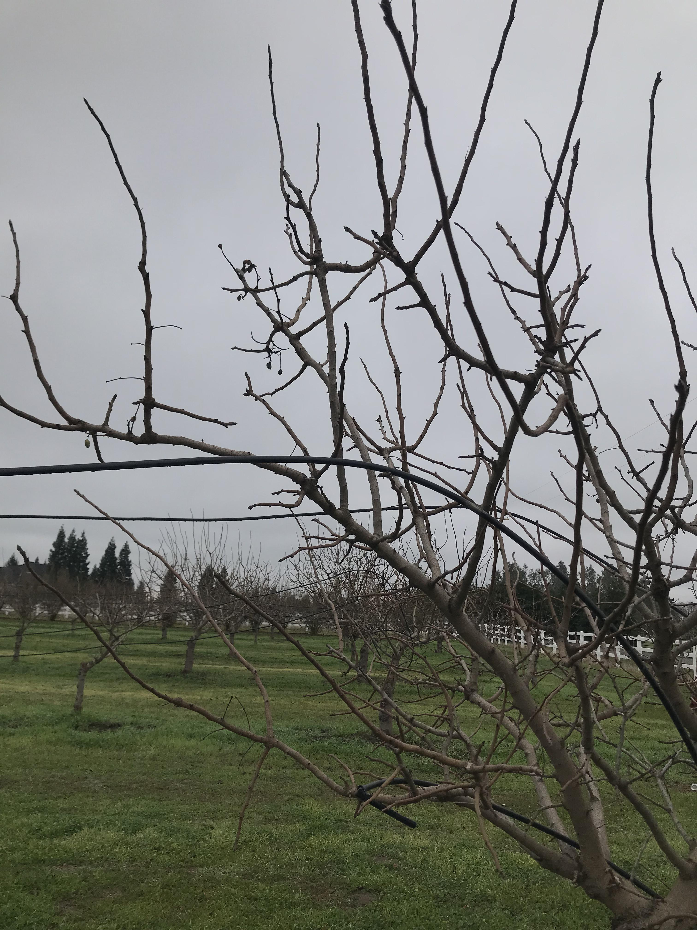
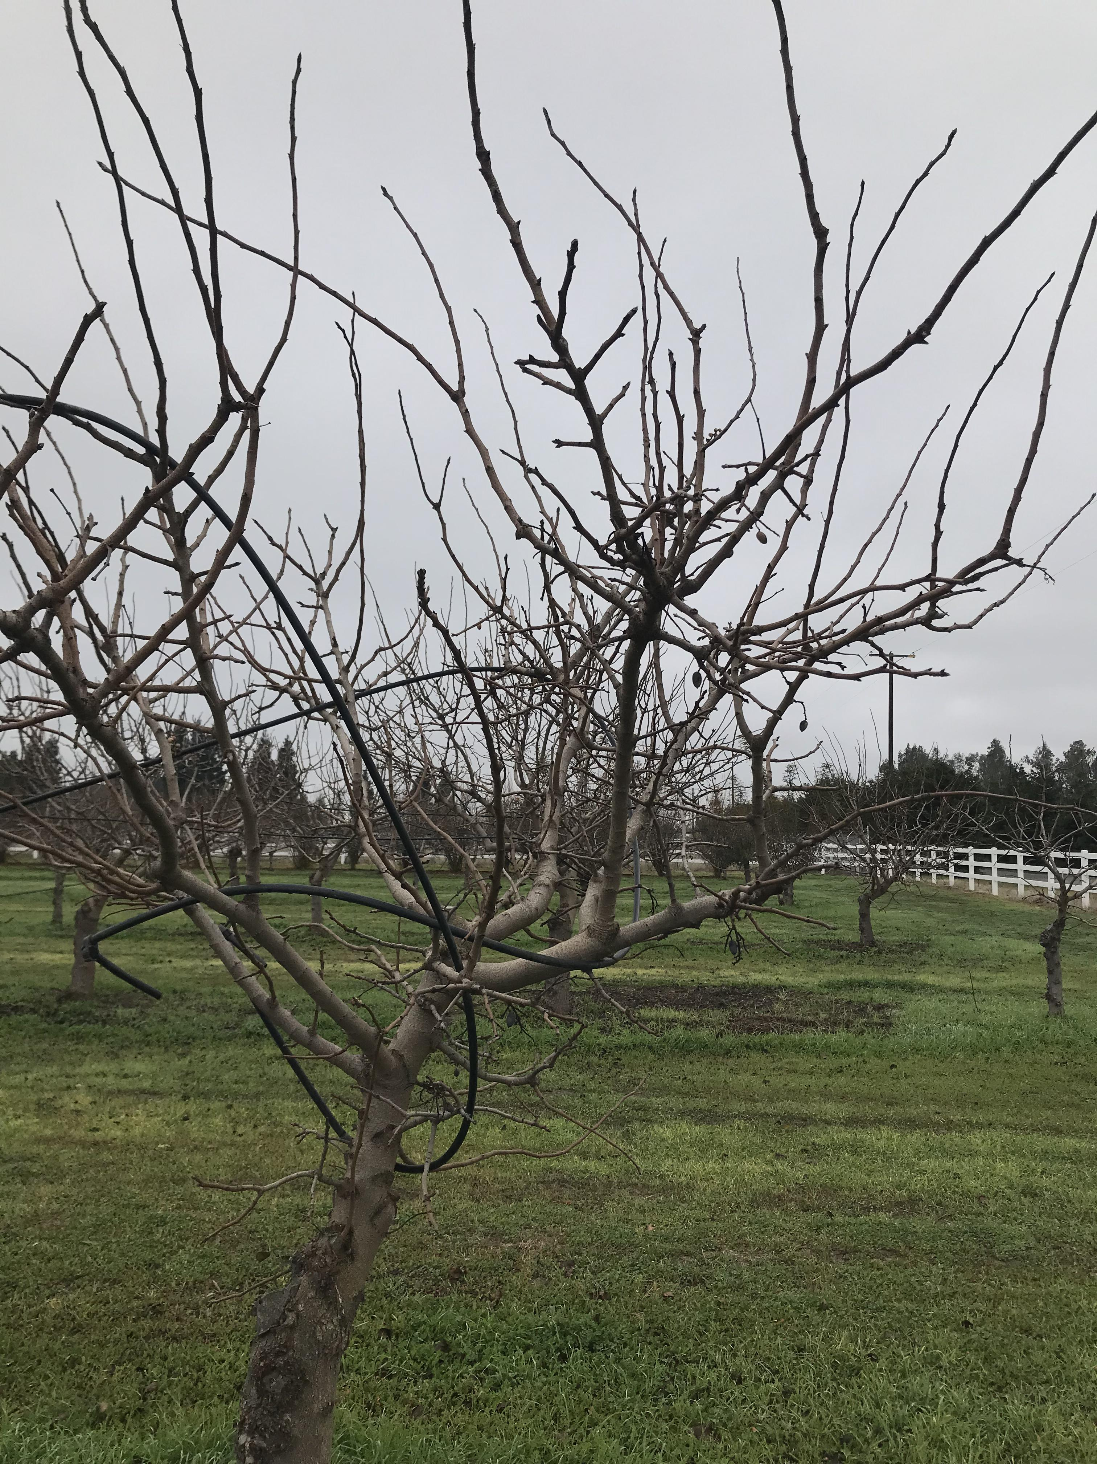

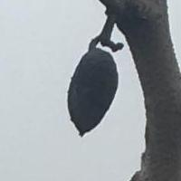
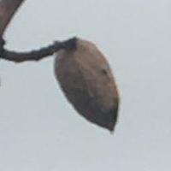
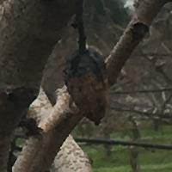
Dataset Curation
Original Dataset
Large images (3024 x 4032)
Augmented Dataset
Cropped images (200 x 200)
Centered on almonds
Increases Original dataset by 6X
D. Ng, C. Schmierer, A. Lin, B. Liu, L. Yu, S. Newsam, R. Ehsani, and X. Lu, “Benchmarking Object Detection Models with Mummy Nuts Datasets”, Bench’22. (To Present)

Slide 39
CNN Algorithms
4 Popular State-of-the-art CNN models
You Only Look Once (YOLO)
Faster R-CNN
MobileNet SSD
CenterNet

Slide 40

You Only Look Once (YOLO)
Means detector only looks at an input image once before making detections
Anchor box detector
Produces lots of bounding boxes
Reduces them with non-max suppression (NMS)
Very fast inference speed (state-of-the-art)
Competitive Accuracy
J. Redmon, S. Divvala, R. Girshick, and A. Farhadi, “You only look once: Unified, real-time object detection,” 2015.

Slide 41

Faster R-CNN
Very Deep Network
101 convolutional layers
Learn more features (may not always increase accuracy)
Anchor box detector
Fast inference speed
Very high accuracy (state-of-the-art)
S. Ren, K. He, R. Girshick, and J. Sun, “Faster r-cnn: Towards real-time object detection with region proposal networks,” 2015.

Slide 42

MobileNet SSD
Very compact model
Lowered from 138m to 4.2m parameters
Good for mobile devices
Still has enough compute strength
Makes 8732 detections per class
Fast and efficient inference
Lower accuracy
W. Liu, D. Anguelov, D. Erhan, C. Szegedy, S. Reed, C.-Y. Fu, and A. C. Berg, “SSD: Single shot MultiBox detector,” in Computer Vision – ECCV 2016, pp. 21– 37, Springer International Publishing, 2016.

Slide 43

CenterNet
Focuses on center points of each box detection
101 convolutional layers
Scale invariant
Creates heatmap
No anchor boxes
Fast inference speed
Good accuracy
K. Duan, S. Bai, L. Xie, H. Qi, Q. Huang, and Q. Tian, “Centernet: Keypoint triplets for object detection,” 2019.

Slide 44


CNN Model Performance Comparison
D. Ng, C. Schmierer, A. Lin, B. Liu, L. Yu, S. Newsam, R. Ehsani, and X. Lu, “Benchmarking Object Detection Models with Mummy Nuts Datasets”, Bench’22. (To Present)

Slide 45


CNN Model Performance Comparison
D. Ng, C. Schmierer, A. Lin, B. Liu, L. Yu, S. Newsam, R. Ehsani, and X. Lu, “Benchmarking Object Detection Models with Mummy Nuts Datasets”, Bench’22. (To Present)

Slide 46

Morning Star Company
Problem Statement
Tomato plant transplanting process not 100% successful
In each unit of tomato field, expect to see a tomato sapling
If not, considered mis plant
Solution
Precision vision system to detect and count tomato saplings
Compare system count vs starting batch count
Provides success rate data
Using YOLOV4 for real time detections
Achieved 97% counting accuracy
Team: Moises Limon, Alberto Melchor-Maldonado, Darren Ng, Ivan Palacios, Christine Pham

Slide 47

Notes:
https://youtu.be/dvm3Vxm20HE

Slide 48
Content
Machine Learning and Convolutional Neural Networks
TensorFlow Applications
AgriFood: Precision Agriculture
Problem Statement
CNN Models
Mummy Almond Nut Problem
Morning Star Company
TensorFlow Object Detection
Reinforcement Learning: TF-Agents
Others
Notes:
Aerial imagery, citrus fruit, mummy nuts, NLP, turn-based games,

Slide 49
Content
Machine Learning and Convolutional Neural Networks
TensorFlow Applications
AgriFood: Precision Agriculture
Problem Statement
CNN Models
Mummy Almond Nut Problem
Morning Star Company
TensorFlow Object Detection
Others
Notes:
Aerial imagery, citrus fruit, mummy nuts, NLP, turn-based games,

Slide 50
TensorFlow Object Detection
The easiest way to get started with object detection on your own computer
Tensorflow Object Detection in 5 Hours with Python | Full Course with 3 Projects - YouTube
Supports multiple CNN model algorithms (CenterNet, Faster R-CNN, etc.)
models/research/object_detection/models at master · tensorflow/models (github.com)
Works seamlessly with TensorBoard

Slide 51

Sign Language Object Detection
4 Classes: T, F, O, D
15 images per classification
2000 steps/epochs
Precision & recall of 85%
Loss of 0.035 by finish

Slide 52

CNN Model Evaluation: Trouble Shooting
Lots of problems can occur
“Black box” = hard to debug
Common Issues:
Zero detections after inference
Detection boxes positions are off
Loss value gets stuck (not low enough)
Model inference good at training images, not new images
Nut 100%

Slide 53
Trouble Shooting
Zero detections after inference
Some CNN models can suffer from scale size. Tiny objects are especially difficult
Test input image differs too much from training set
or training set is not diverse enough
Detection boxes positions are off
Check that annotation bounding boxes in training set are tight around each target object
Could be an issue related to anchor box sizing, may need tuning
Tiny objects tend to cause this too
Loss value gets stuck (not low enough)
Training dataset may be difficult to learn, CNN may not be extracting enough features
Gradient descent may be getting stuck, increase learning rate (not too much!)
Model inference good at training images, not new images
Model is overfit, try training for less time (monitor loss rate and stop at convergence)
Bias in overrepresented object and model cannot detect underrepresentation

Slide 54
Further Improving your Model
Improve dataset
More data!
Tighter annotation bounding boxes for training
Training data should have equal variety in target objects (increase number of underrepresented objects)
Stop training at the right time
Monitor loss rate, when loss values doesn’t decrease anymore stop training
prevents overfitting
Don’t stop training too early either, try to get loss value to at least less than 0.1
Understanding precision/recall values
After running inference, based on image context, try to understand why some objects get detected and why others may not
Advanced:
Adjust hyperparameters
Tune anchor boxes
Supplement CNN with computer vision techniques

Slide 55
Other TensorFlow Applications
Reinforcement Learning: TF-Agents
Game AI
Environment learning/robotics
Uber
UberEATS
Marketplace Forecasting
Customer Support (NLP)
Self-Driving Cars
Breast Cancer Detection
UCI Breast Cancer Wisconsin Data Set: UCI Machine Learning Repository: Breast Cancer Wisconsin (Diagnostic) Data Set
Disability
Eye tracking
Hand gesture detection
Safety
Car operator drowsiness detection
much more...

Slide 56
Recap
TensorFlow -> Machine Learning and Deep Learning
The structure of Deep Learning and how it learns
Evaluating Deep Learning performance and how to improve
Making your own dataset + image processing
Training Neural Network Workflow
Different popular open-source CNN models and performance
Saw additional applications of TensorFlow object detection

Slide 57
CNN Workflow
Figure out your dataset
Downloaded
Collected
Figure out what CNN Model
YOLO
Faster R-CNN
CenterNet
MobileNet SSD
Lots more...
Train!
Inference!
Evaluate
GOOD LUCK!!
Feel free to reach out to me if you have any questions!
Email: dng350@ucmerced.edu

Slide 58
Thank you! Questions?
Notes:
TensorFlow
Model Garden overview | TensorFlow Core
A Neural Network Playground (tensorflow.org)
Object detection | TensorFlow Lite
models/research/object_detection/models at master · tensorflow/models (github.com)
What is Deep Learning? | IBM
A Comprehensive Guide to Convolutional Neural Networks — the ELI5 way | by Sumit Saha | Towards Data Science
UCI Machine Learning Repository: Breast Cancer Wisconsin (Diagnostic) Data Set
Tensorflow Object Detection in 5 Hours with Python | Full Course with 3 Projects - YouTube

Slide 59

What is the difference between deep and shallow neural networks? - Quora

Slide 60

S. Feng, H. Zhou, H. Dong, “Using deep neural network with small dataset to predict material defects” 2019

